Slide 1
Commerce Bank Project
Group #5:
Aanchal Tiwari
Alper Erel
Michael Homer
Nikoloz Dzidzava
Od Purevsuren

Slide 2

Notes:
Nik: Have you ever been lost without a bank app that doesn’t tell you your transaction details for all of your accounts, customizing notifications, and import all your transaction history into a CSV file?
Od: Gee golly, I really wish I had a bank app that told me my transaction details for all of my accounts, customizing notifications, and imported all of my transaction histories into a CSV file!

Slide 3

App
Notes:
Alper: Well, now you can! With the newest, greatest Commerce Bank App.
*Commerce Bank logo appears*
Aanchal: Hello, we are group 5 for the Commerce Bank Project. We are going to go through the UI of the app as a ‘regular’ customer and what they can do with the app.
Michael: We will also go in-depth into the backend of the project, what we did to implement these details, and the schema as well as the security features, or even how the application works.

Slide 4
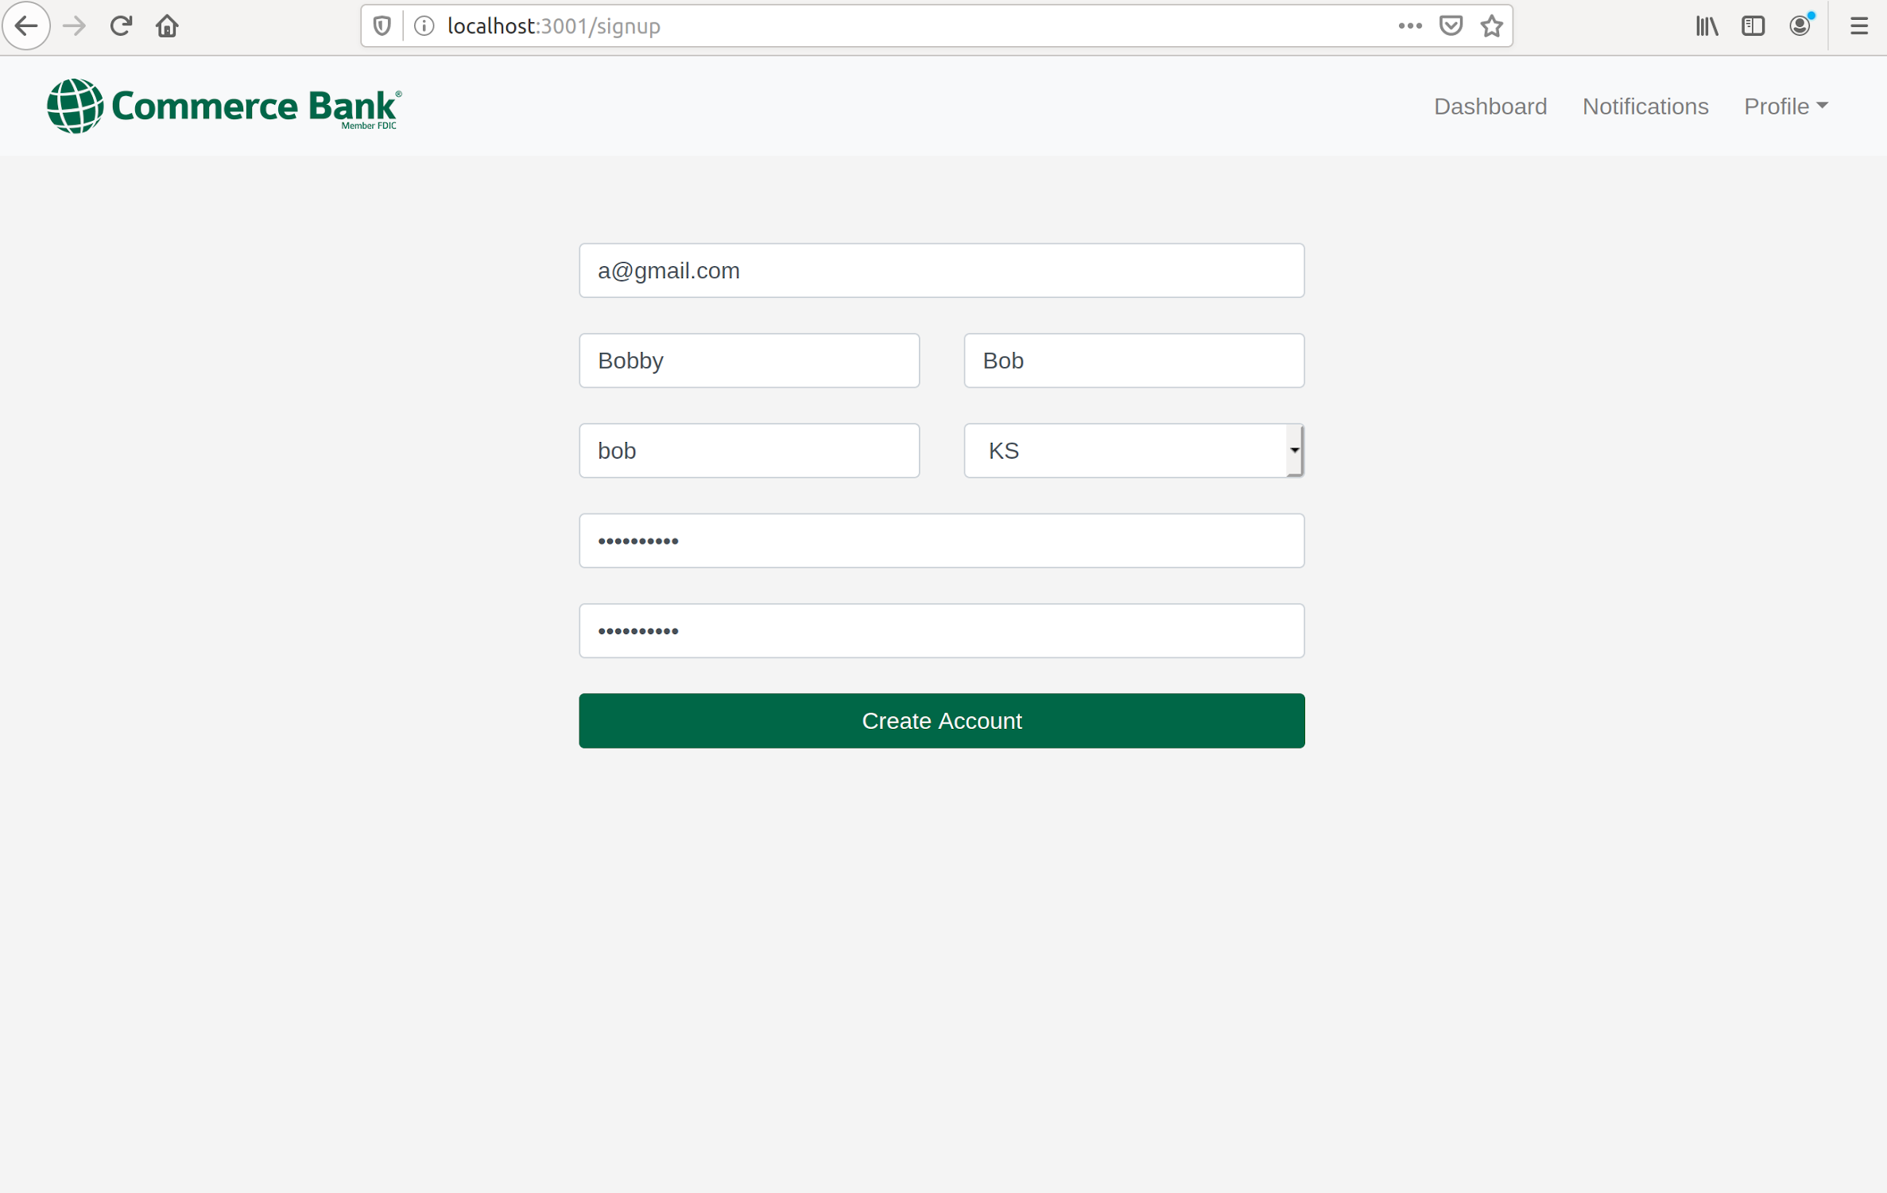
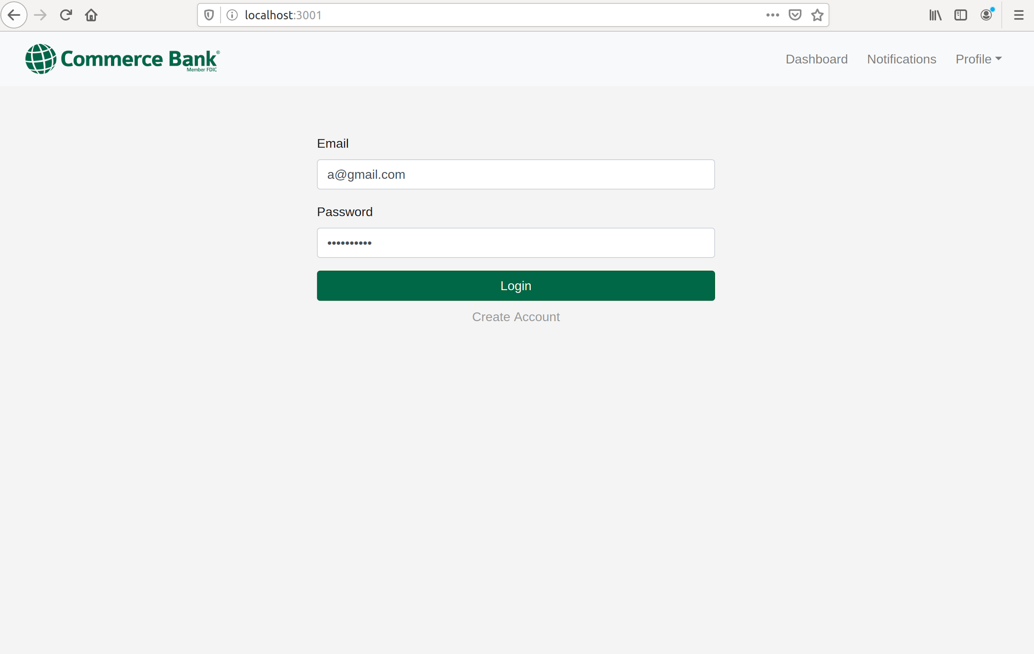
Signing Up/Logging In
Notes:
Od - goes through the ‘beginning’ of the app ie. registering, logging in (errors), navigating to the dashboard

Slide 5
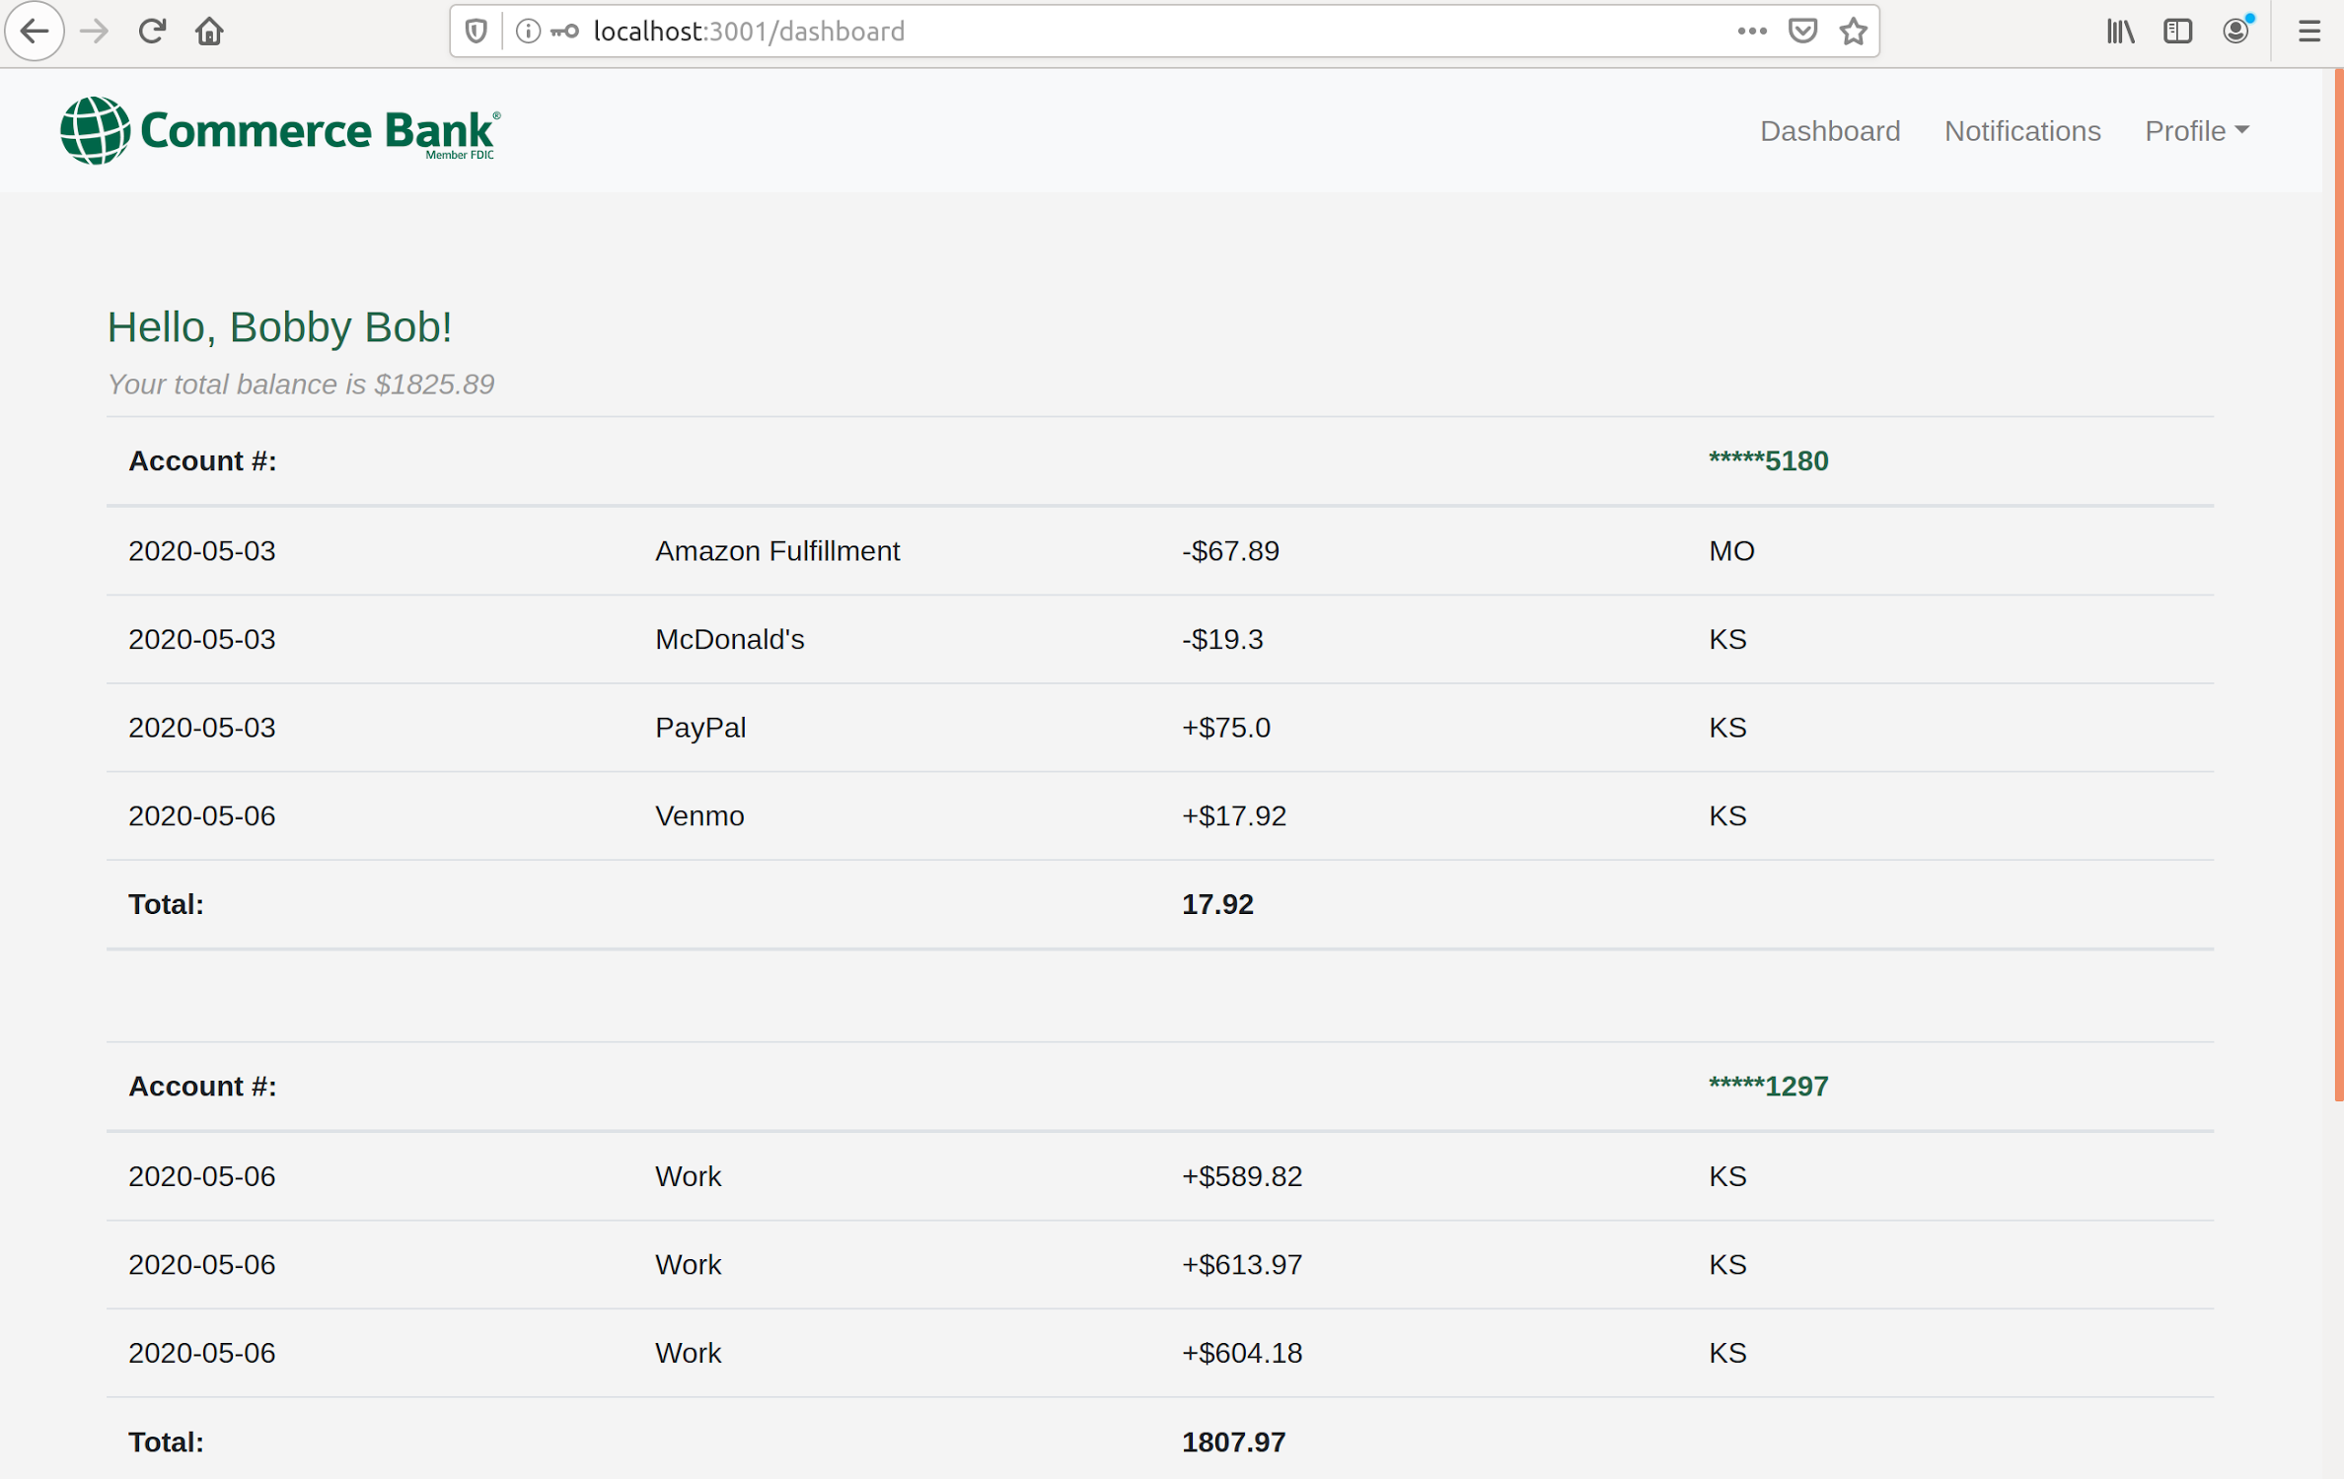
Dashboard

Slide 6
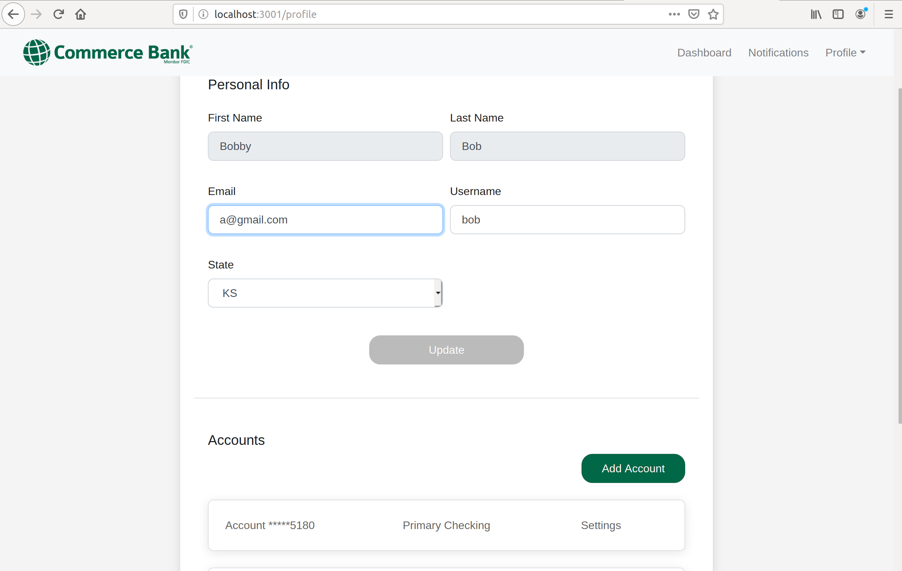
Profile Settings

Slide 7
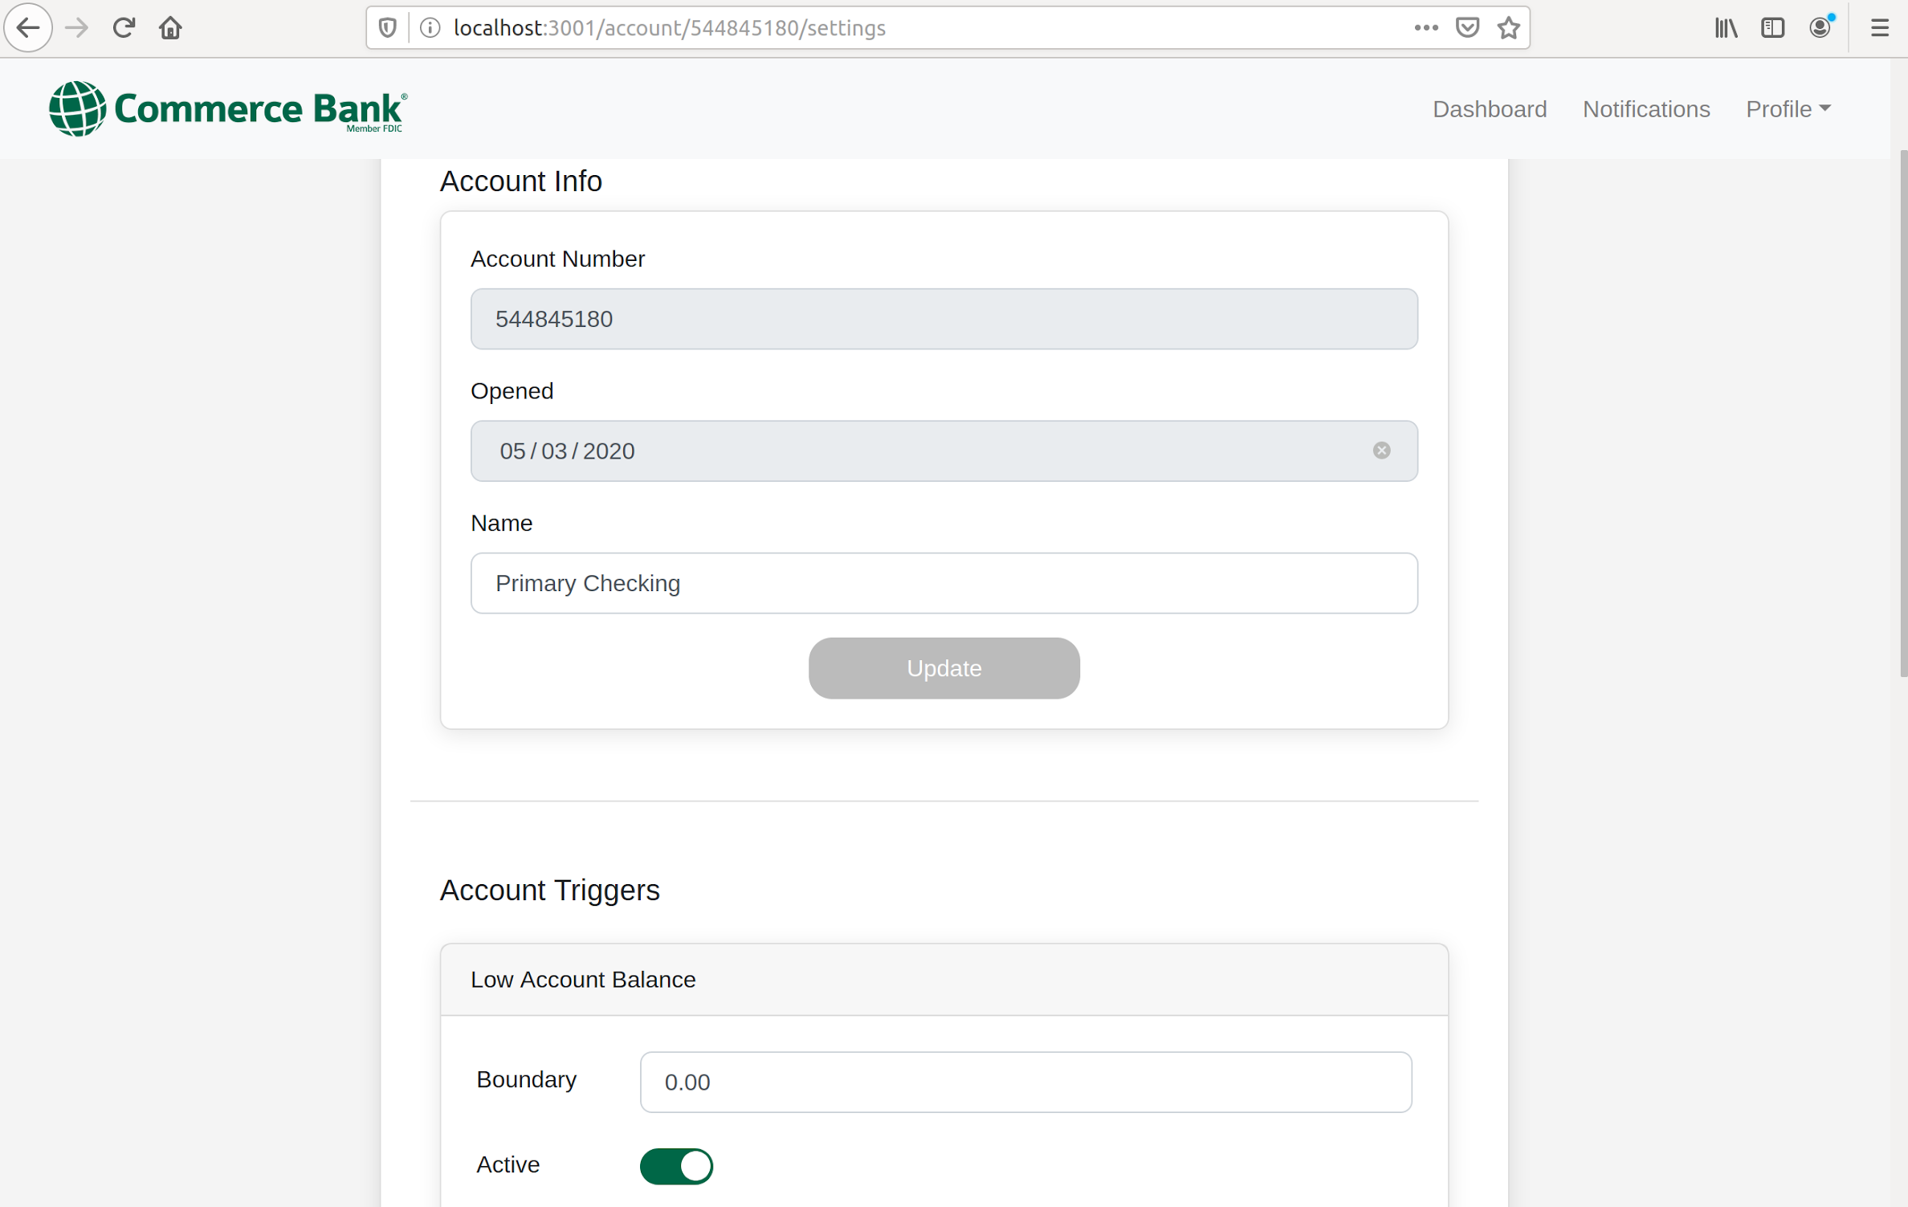
Account Settings

Slide 8
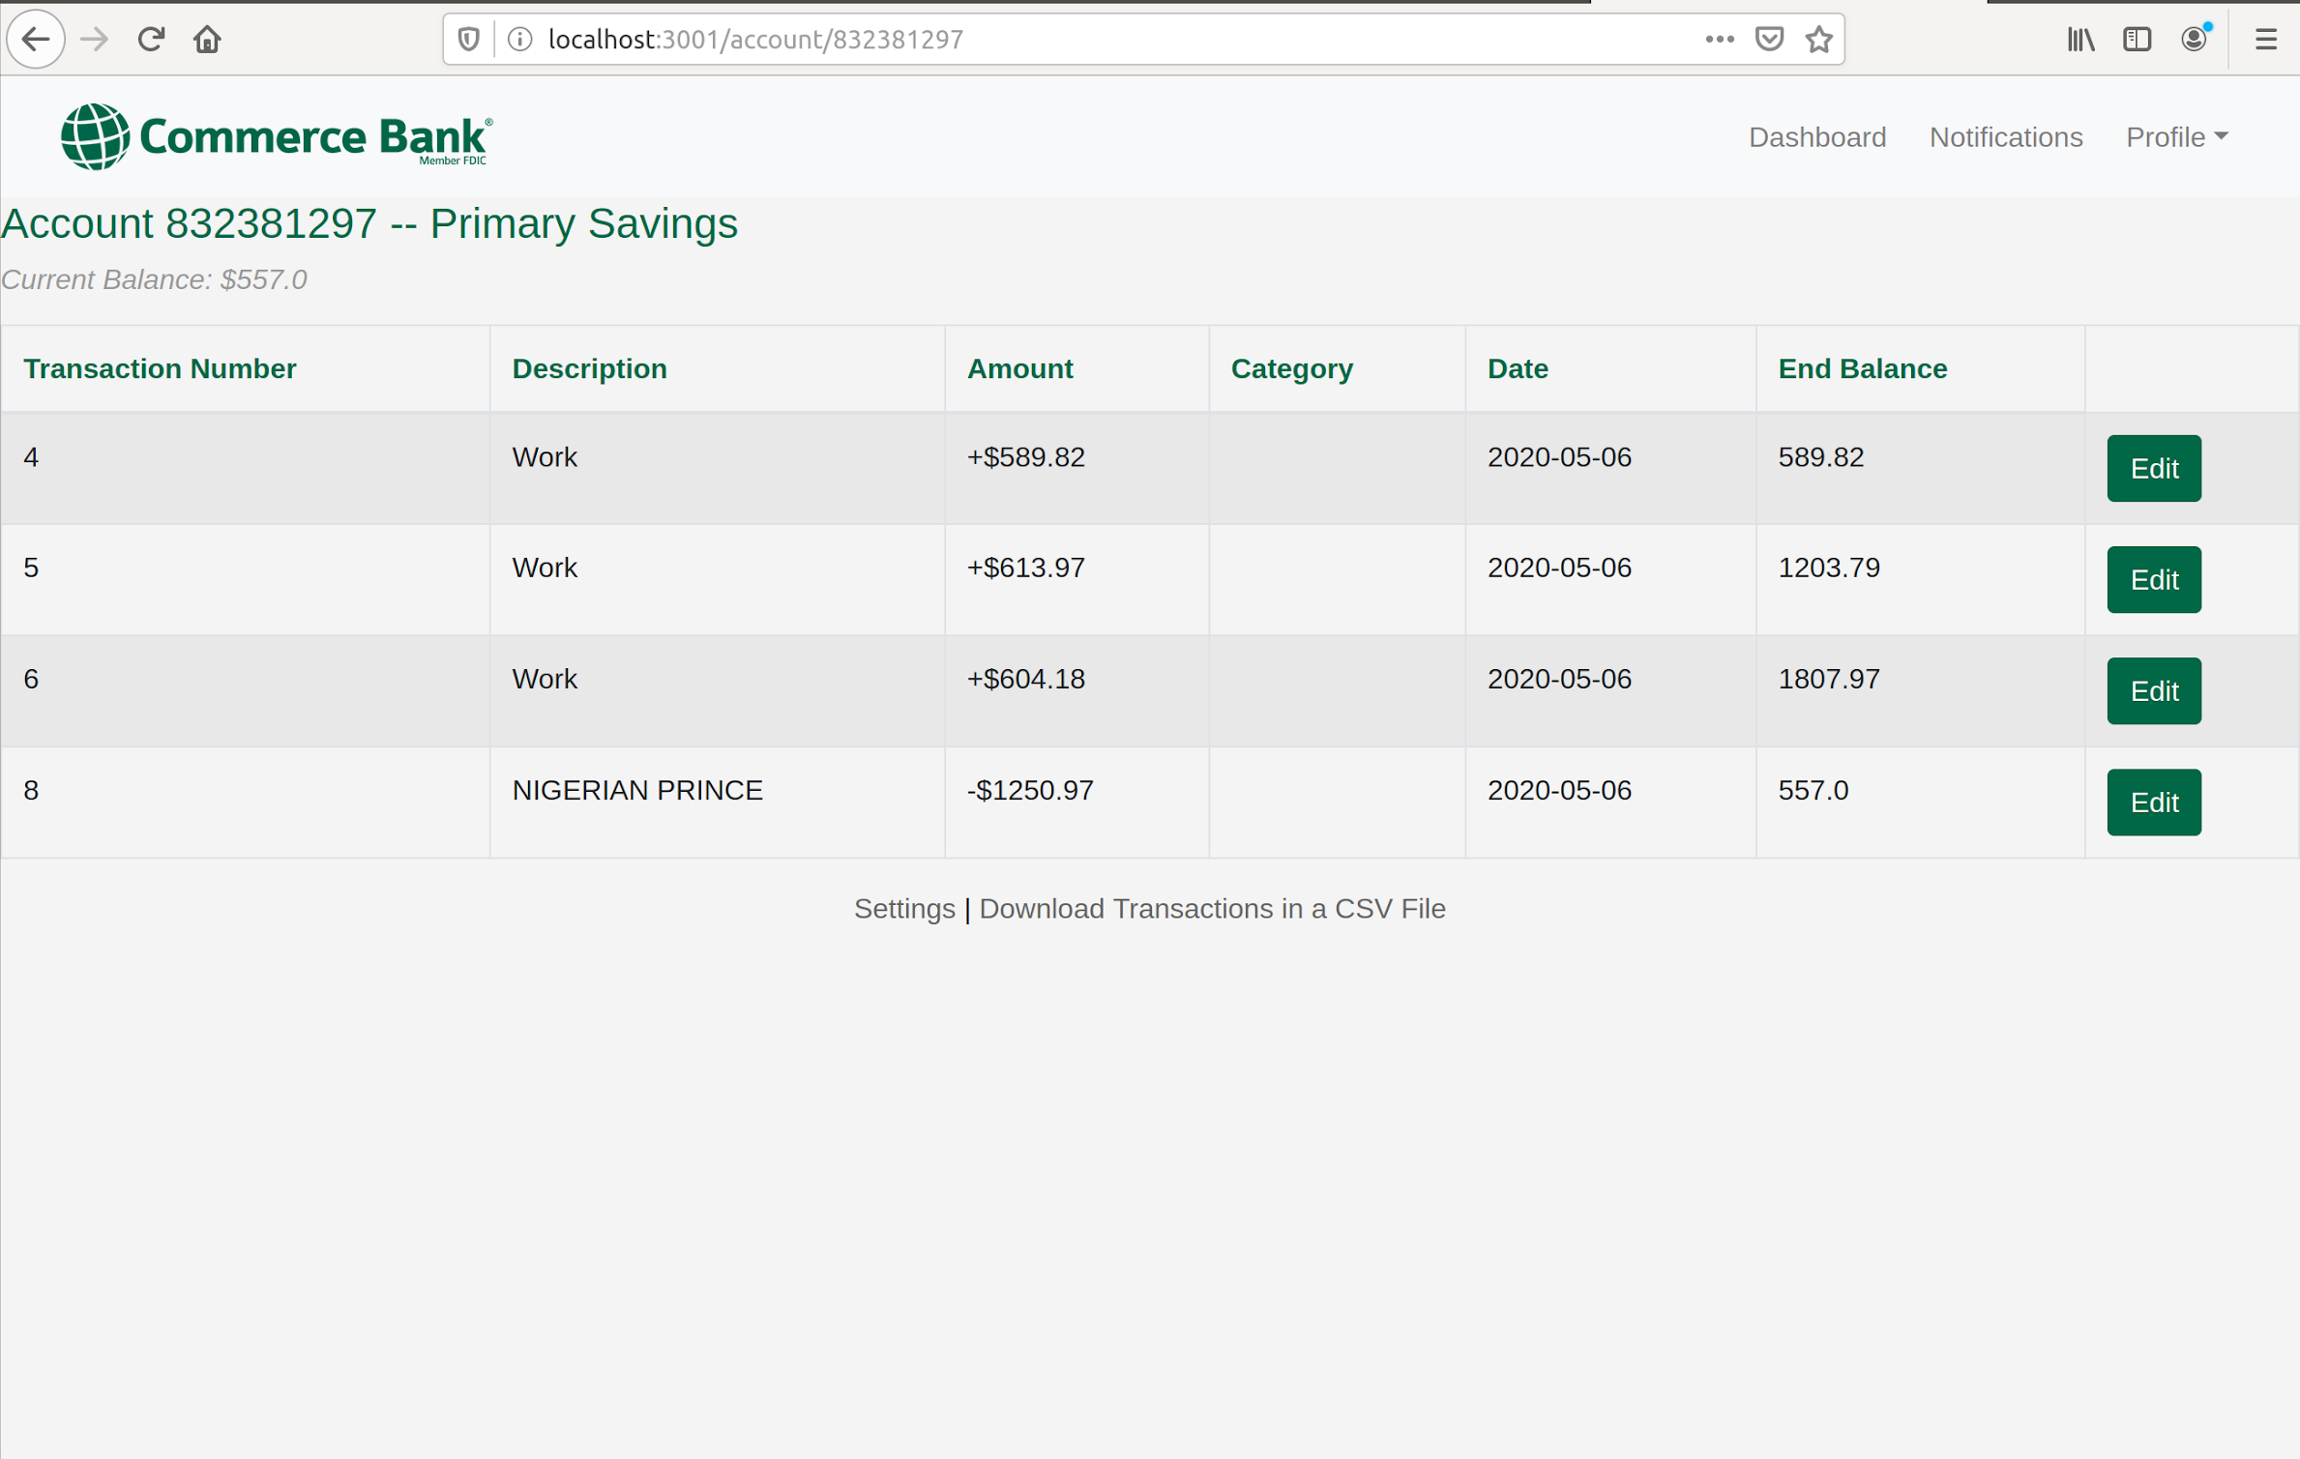
Accounts

Slide 9
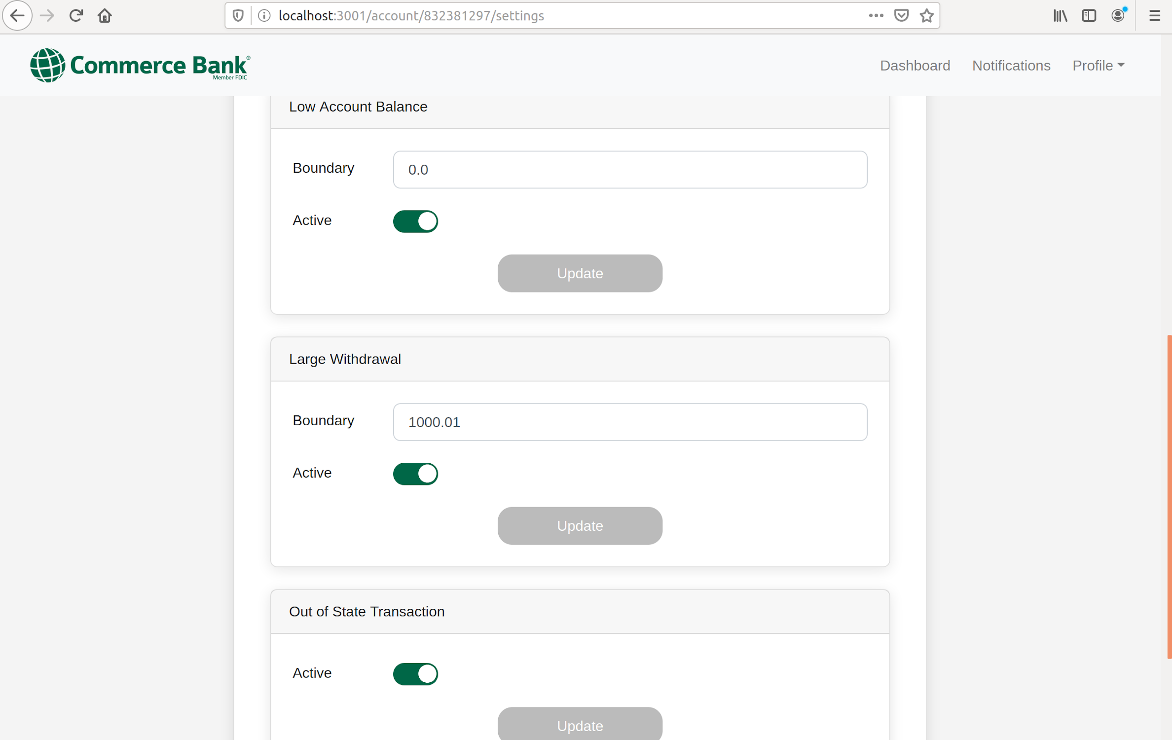
Customizing Triggers

Slide 10
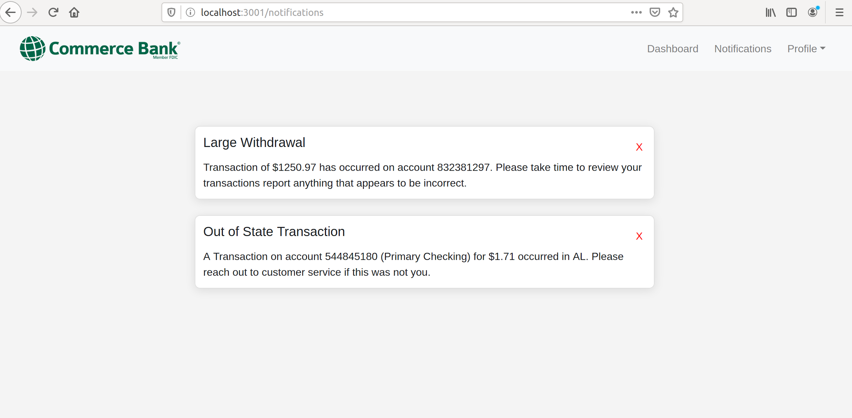
Notifications
Notes:
Od - LAST PAGE

Slide 11
Dashboard

Slide 12
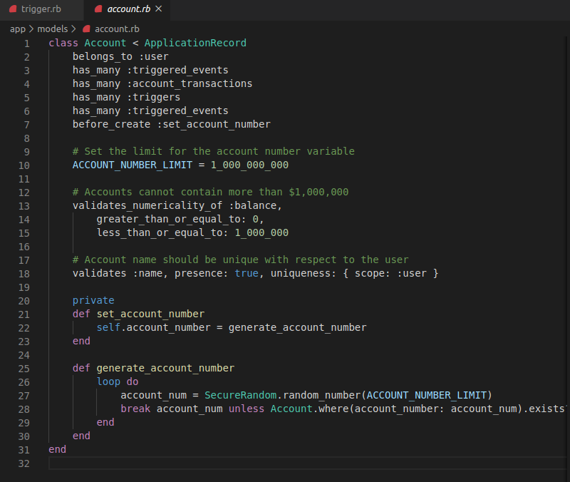

Slide 13
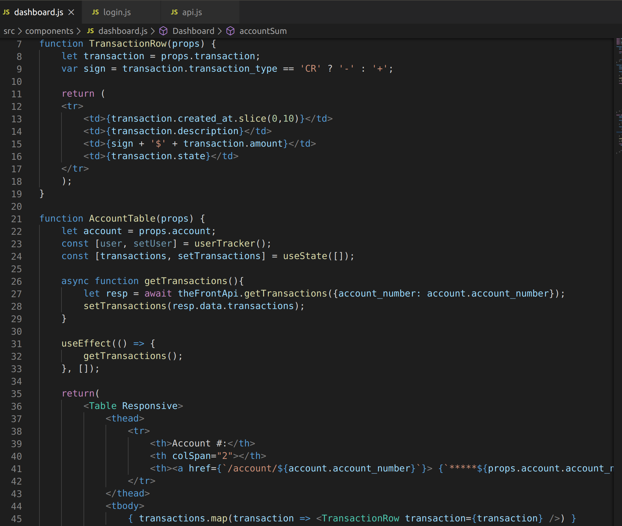
Notes:
Aanchal - directs to account details, sets categories for new transactions, imports to CSV file, customizing notification and triggers (if we can do this idk)

Slide 14
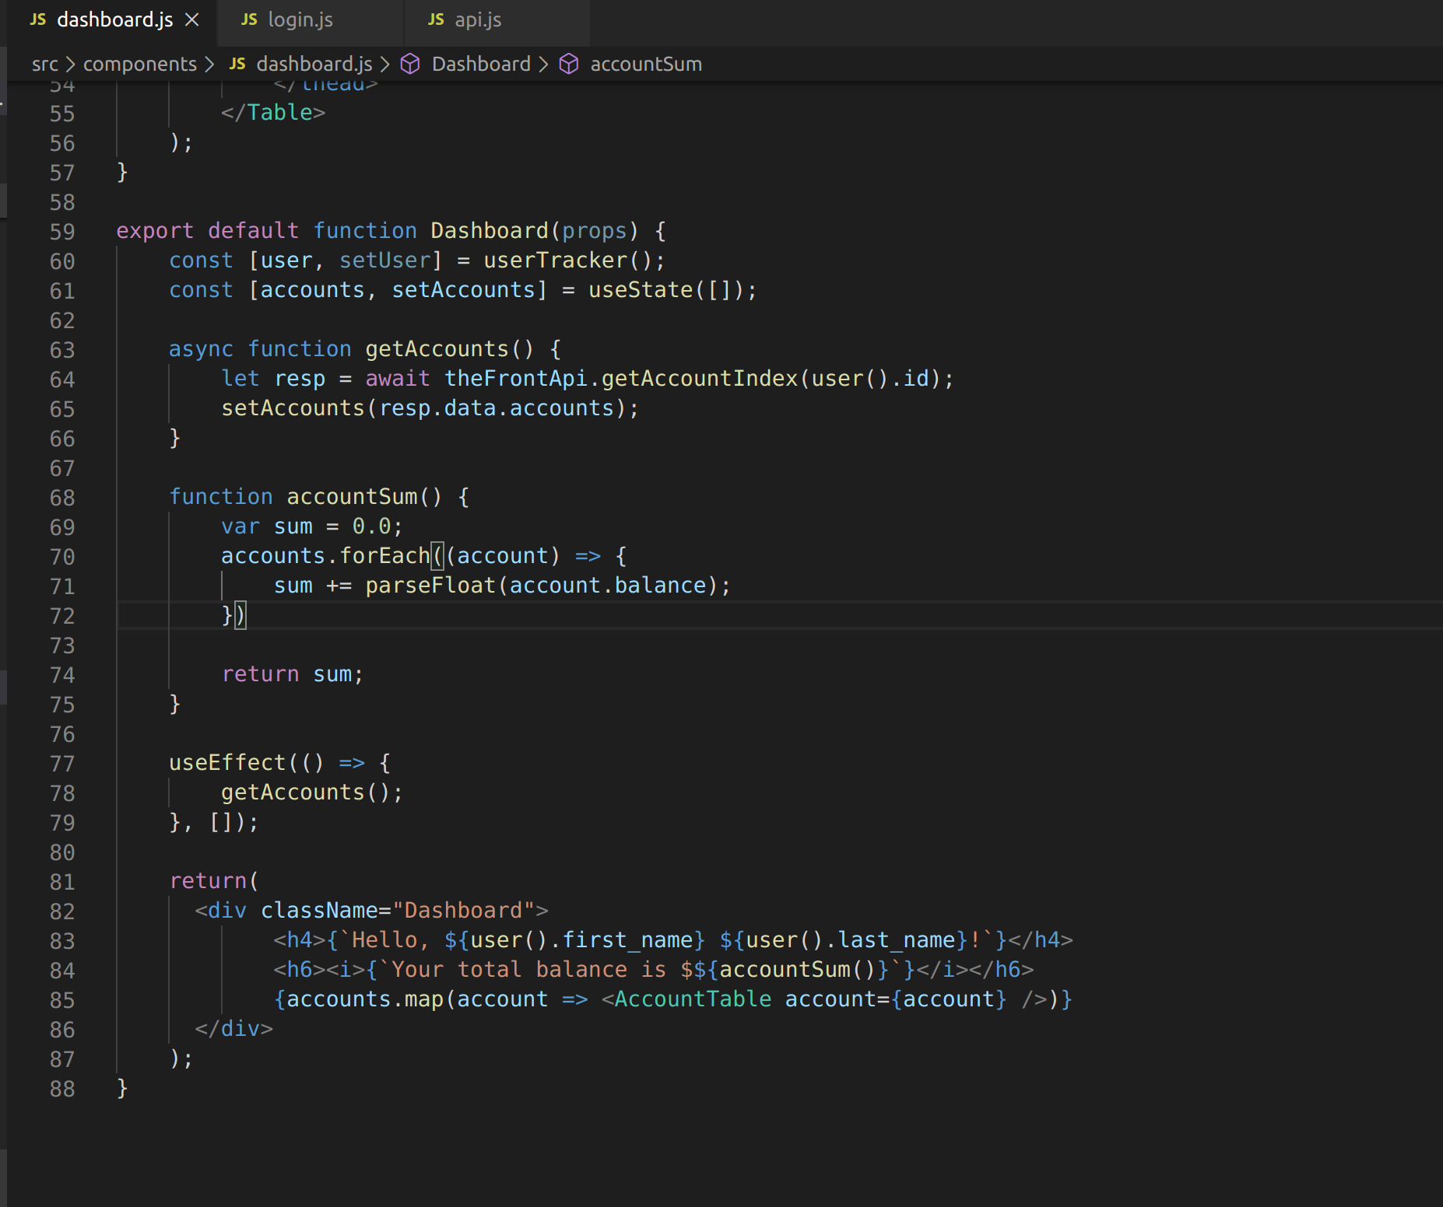

Slide 15
Accounts

Slide 16
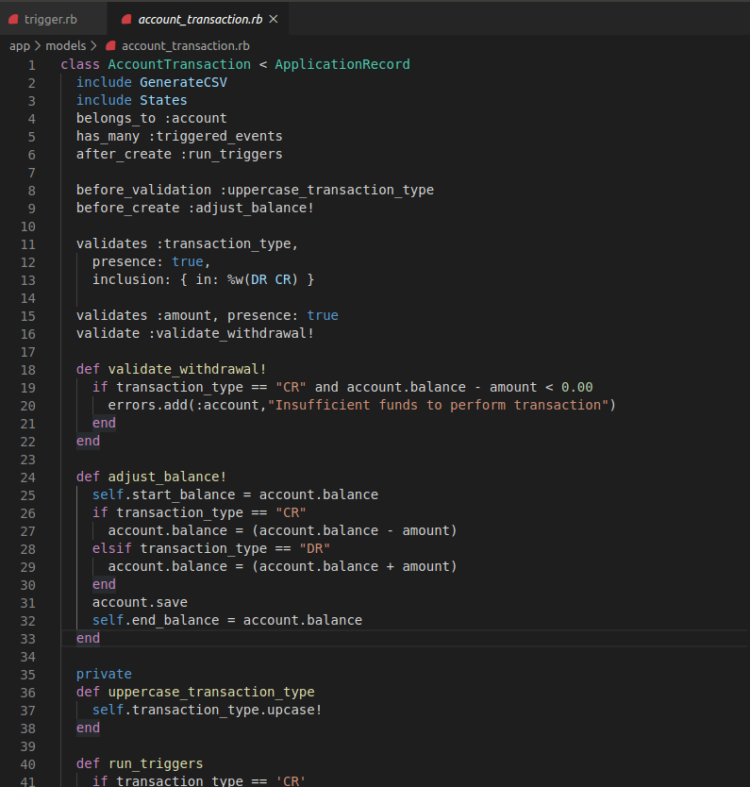

Slide 17
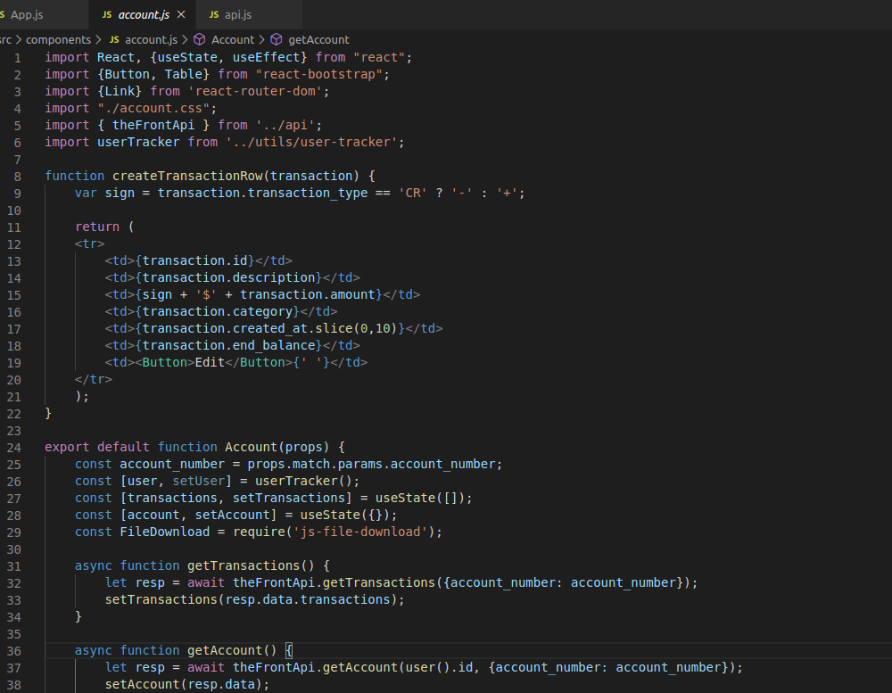

Slide 18
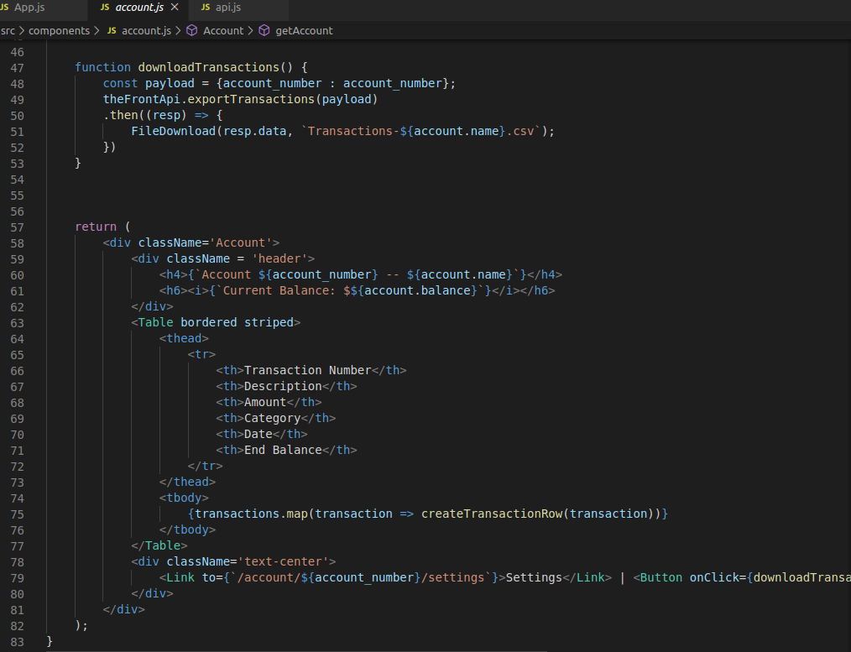

Slide 19
Notifications
There are only 3 types of notifications on our Bank App
Large Withdrawal
Low Balance
Out of State Transaction
In order to receive notifications user has to set triggers.
After triggers are set, user will be notified if any transaction violates trigger constraints.
Notifications can be updated
Update -change read flag as seen, if the User reads the notifications
Cannot change the description of the message
Nikoloz Dzidzava
Notes:
Nik - the tech BEHIND the notifications page, what did he do to implement it

Slide 20
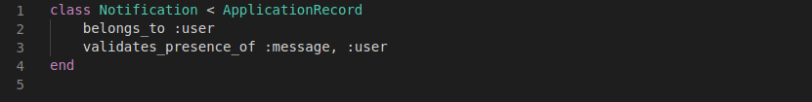
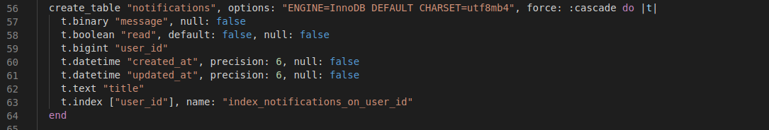
Backend of Notifications

Slide 21
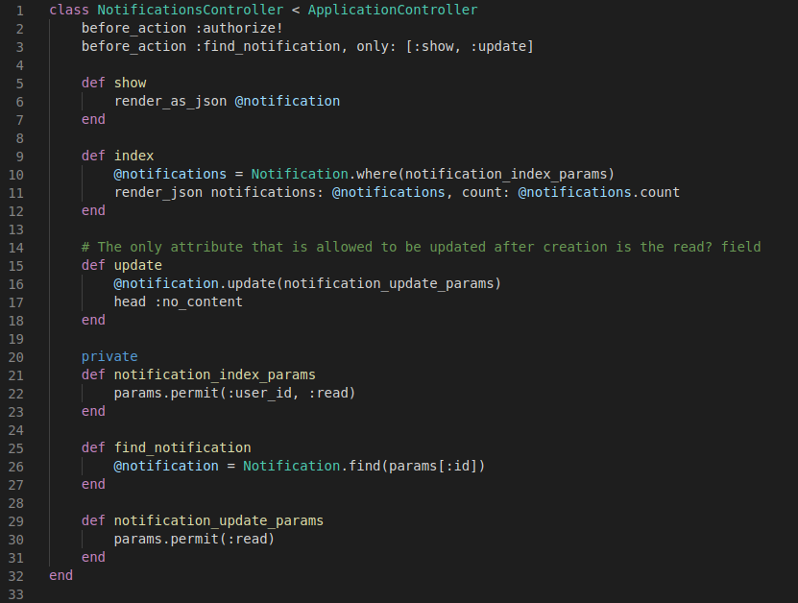
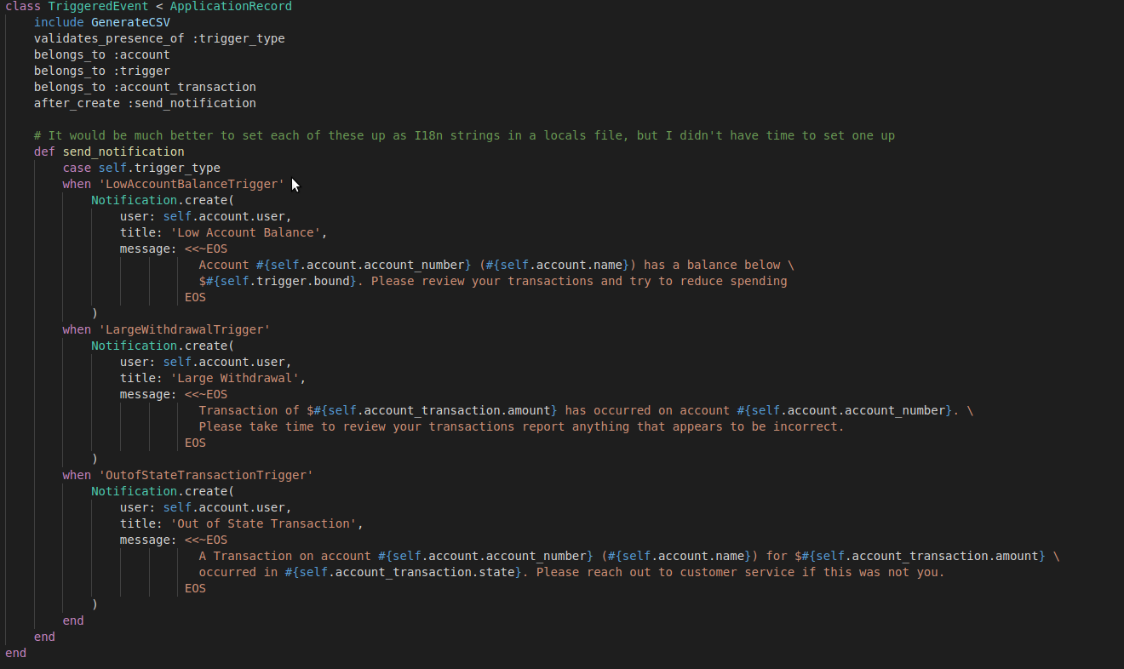
Notification Creation

Slide 22
Triggers
Users will have to set up their specific triggers to have notifications for them. There will be a variety of triggers, highly customizable. Some of these include:
out-of-state transactions,
large purchases,
and minimum account balances.
Users can set up multiple triggers for notifications or have zero of them. They will get notifications depending on their trigger preferences.
Notes:
Alper - in-depth on triggers, explain the backend of triggers and interacting with the UI, more things TRANSACTIONS

Slide 23
Triggered Events
On the triggered events page, users will have access to a detailed page displaying information regarding the past triggers that were set off.
For a specific triggered event, a user will be able to see details such as the transaction that caused the trigger, the specific trigger type on the account that was set off, the date of event, on which account the trigger was set off etc.

Slide 24
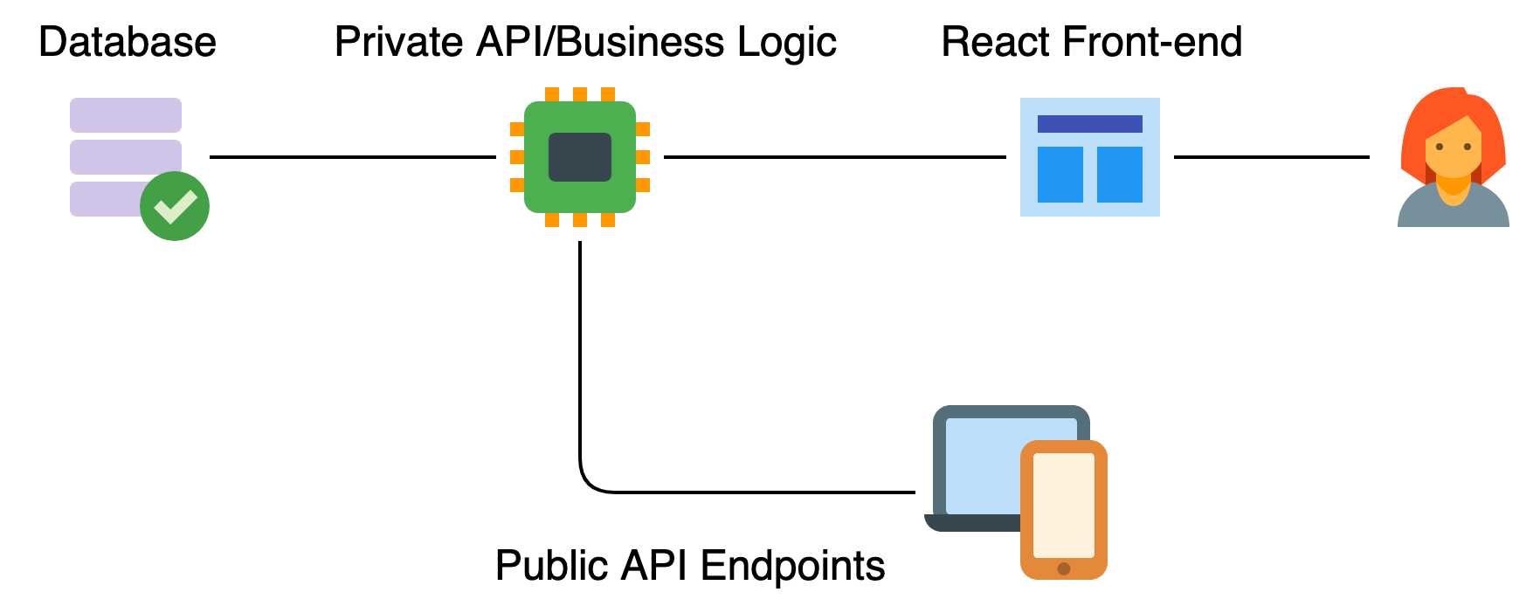
General Architecture
Notes:
For the Architecture of our project we chose a three-tiered approach
Made is easy for us to separate out the implementation of our app;
One layer for data, one for validating, associating, and serving data, and one for presenting data

Slide 25
Database/API
Models:
Account
User
Transactions
Notifications
Triggers
Triggered_events
Custom categories
User sessions
API:
RESTful design
JSON responses
Consistent endpoints and responses
Built in data validation
Does the majority of the heavy lifting for the application
Notes:
Michael - Rather than bog down the front end with data validations, we leave that up to the api. If there is anything wrong it will tell us.

Slide 26
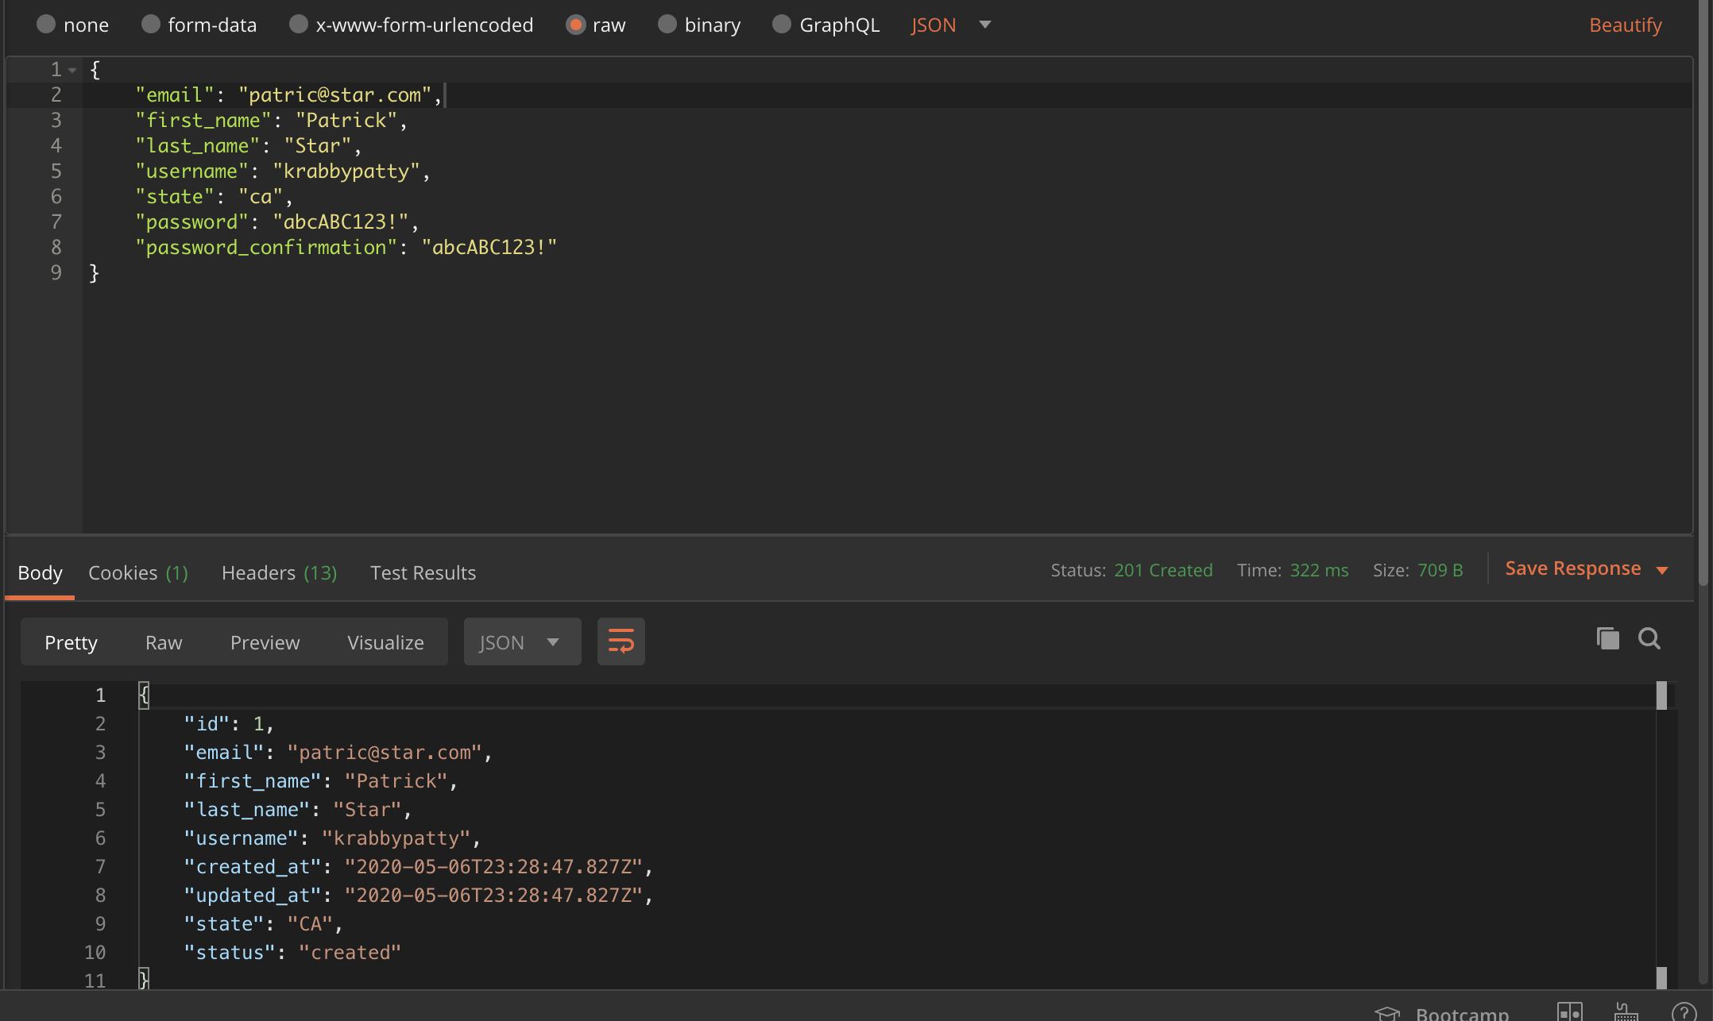
/users
/users/:id (protected)
PUT
GET
DELETE
/users (unprotected)
POST
GET (index)

Slide 27
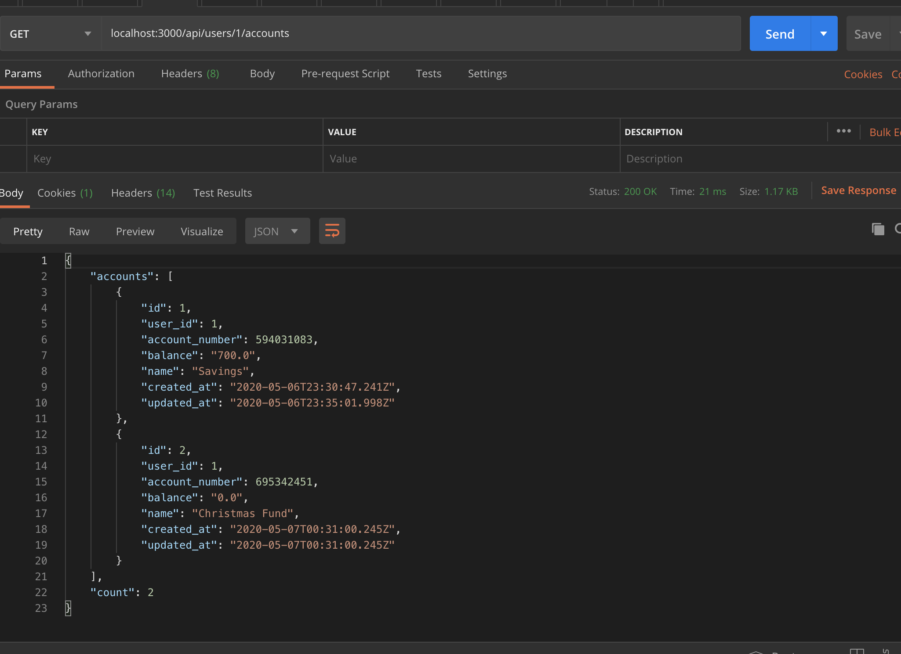
/users/:id/accounts
/users/:id/accounts/:id
PUT
GET
/users/:id/accounts
POST

Slide 28
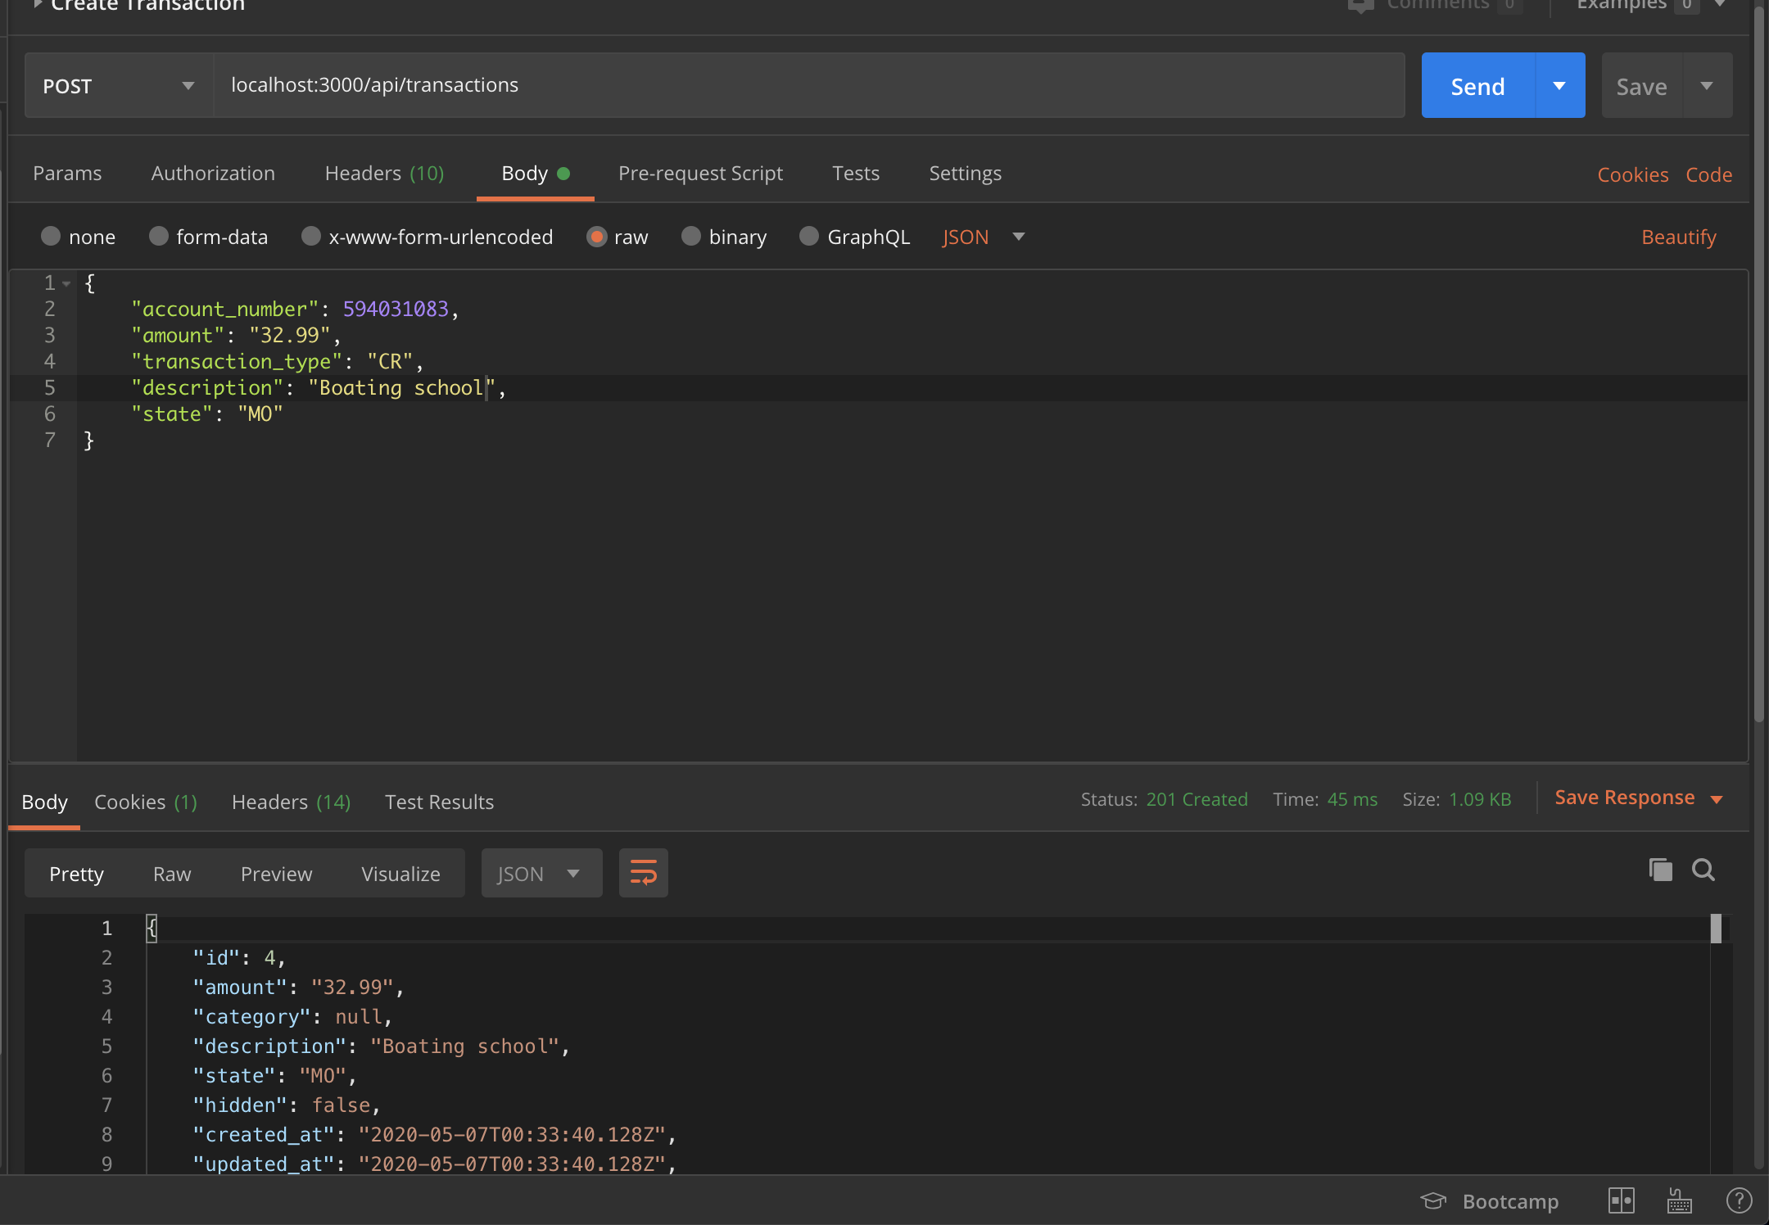
/transactions
/transactions/:id
PUT (only category)
GET
/transactions/search
POST (payload is account number)
/transactions
POST

Slide 29
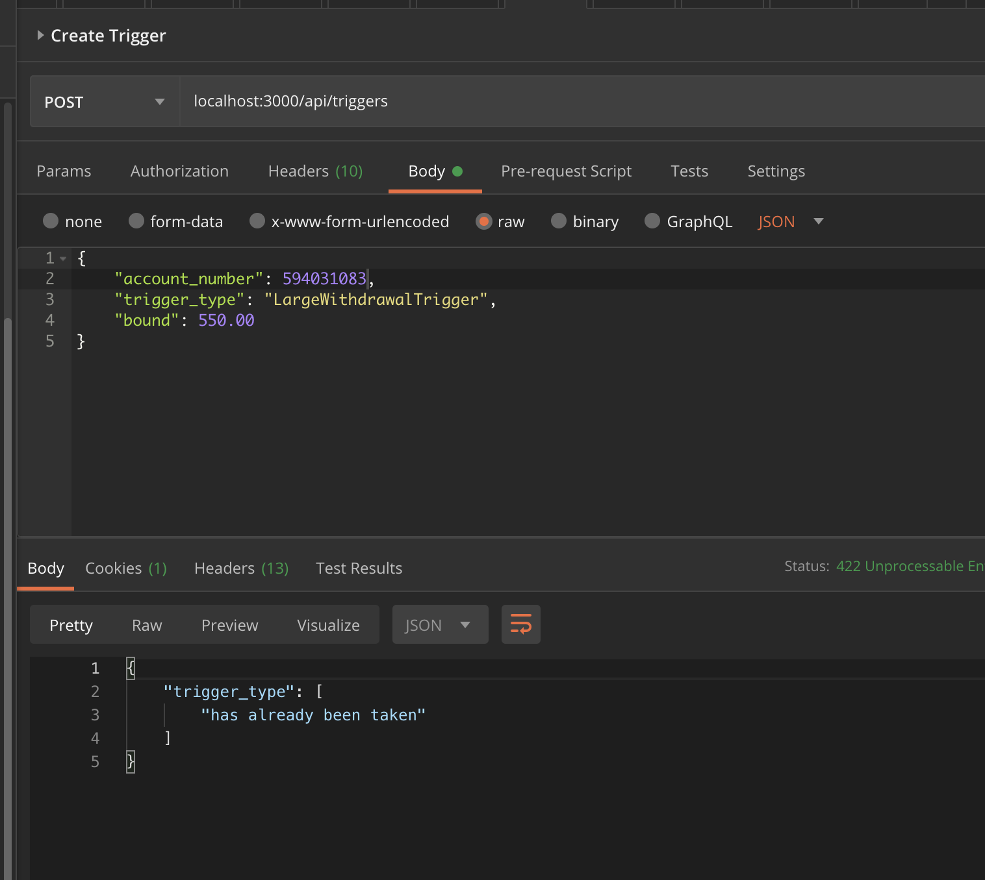
/triggers
/triggers/:id
GET
PUT
DELETE
/triggers/search
POST (account number in payload)
/triggers
POST

Slide 30
Honorable Mentions
/users/:id/notifications
/triggered-events
/session
/custom-transaction-categories

Slide 31
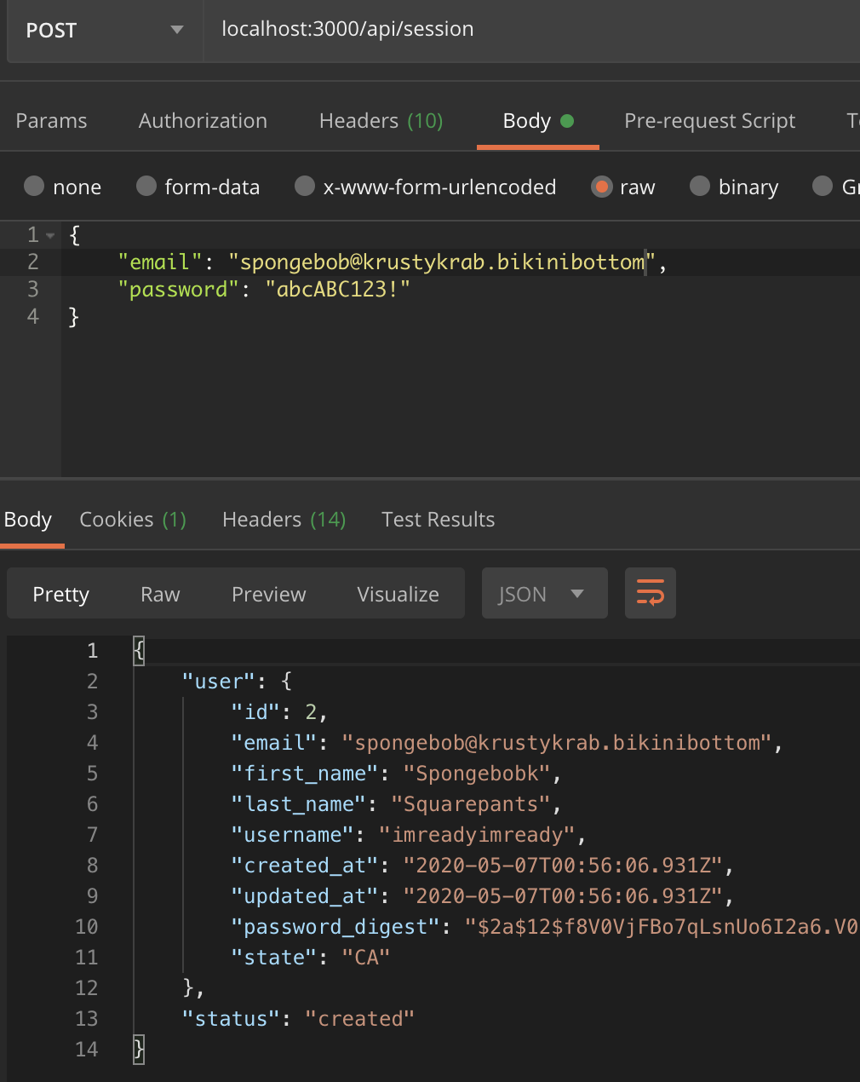
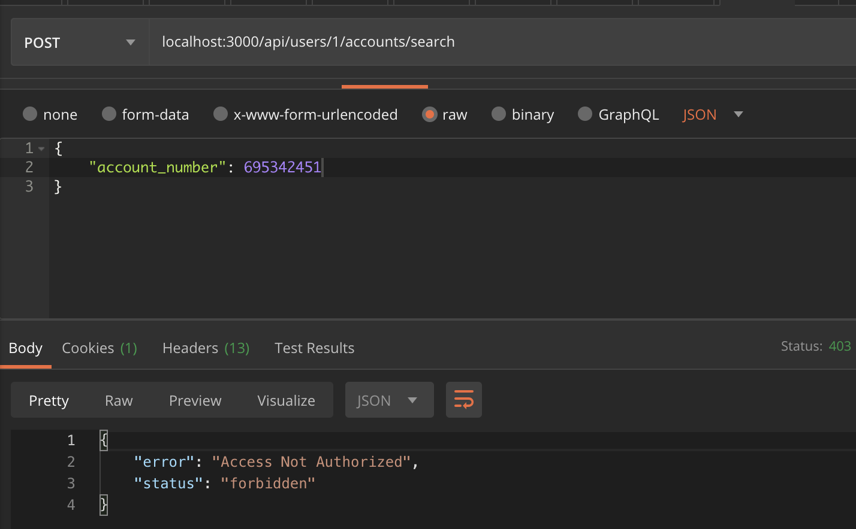
Resource Protection
Logged in as spongebob trying to access patrick’s account info

Slide 32
Security
Encrypted Session Tokens
Salted Passwords
Protection against SQL-injection
Protected routes/resources
Improvements for the future:
Implement a better CORS policy
Implement the use of CSRF tokens
Oauth2.0 tokens instead of sessions for api
HTTPS

Slide 33
Known bugs/Things that We Didn’t get to :(
Not all 500 errors are caught by our front end
Notifications show up on notification page, but user is not notified
There is an endpoint to add additional bank accounts to the user, but the ui doesn’t hook up to it
Endpoints don’t allow for basic parameters such as limit, offset, etc.
The API is a complete, finished product; The UI still needs quite a bit of TLC
Authentication/authorization is a bit dodgy
Wanted to deploy to AWS with docker containers, didn’t get there

Slide 34

Conclusion

